Slide 1
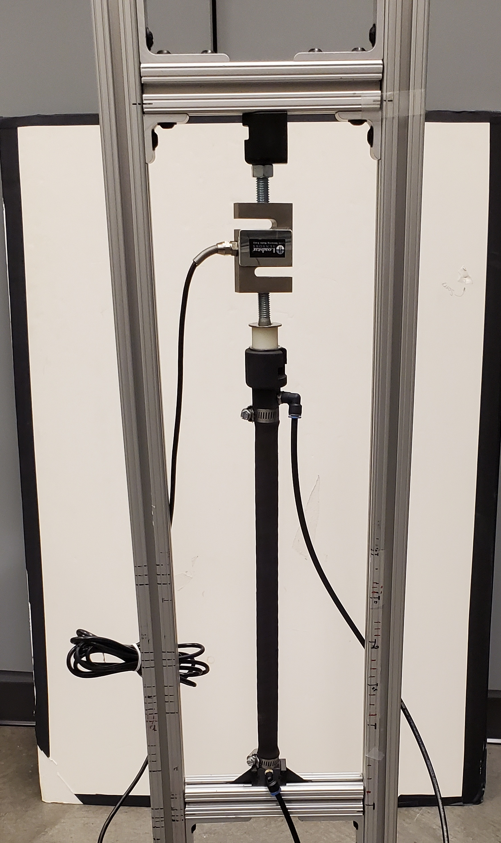
Test Frame
Load Cell
Air supply
End caps
Hose clamps
BPA Length
Air to pressure sensor

